Slide 1
New Masons Evening
First steps into the Craft: the questions you wanted answered, and the people here to help
Thursday 29 October 2026 · Halsey Hall, Cheshunt · Hertfordshire Provincial Mentoring Team
Notes:
Housekeeping before you start: toilets, fire exits and assembly point, phones on silent. Then open warmly: this evening exists because new Masons, and the members of the Light Blues Club, told us what they wished someone had explained. No question is too small.

Slide 2


What tonight is for
You asked. We listened. Brethren across the Province, and members of the Fleet House Light Blues Club, told us what they wished someone had explained in their first two years. Tonight is the answer: three short sessions, plenty of time for questions, and the chance to meet the people whose job is to help you enjoy Freemasonry.
Tonight
1 Mentoring: the people, the basics and the questions you asked
2 Learning and Development: why it matters, Solomon, learning ritual
3 Fleet House Light Blues Club: your club and what is coming up
Your questions, then the bar
Take the handout home: it is everything tonight, on one sheet
Ask anything
Not a Lodge meeting
Cards and pens are on the tables. Write a question at any point and hand it in. We answer them all at the end.
No dress code, no ritual, no regalia. Everything tonight is about how Freemasonry works day to day.
Notes:
Explain the question cards. Point out the handout on every seat: the front is the basics, the back is the jargon buster. Aim to finish the talks by about 8.10pm.

Slide 3
Who you'll hear from
1
2
3
Mentoring
Learning and Development
Fleet House Light Blues Club
W Bro Mark Butcher and
W Bro Wes Pierce
W Bro Tom Golds
Bro Aaron Ball
Provincial Grand Mentor and Deputy Provincial Grand Mentor
Provincial Learning and Development Officer
FHLBC Communications Officer
Notes:
Each presenter: one sentence on when you were initiated and what you remember feeling. It tells the room that everyone up here started exactly where they are.

Slide 4
1
Mentoring
The people here to help you, the basics nobody explains, and the questions you asked
W Bro Mark Butcher, Provincial Grand Mentor ·
W Bro Wes Pierce, Deputy Provincial Grand Mentor

Slide 5



Who's who in your corner
Your Personal Mentor
Your Lodge Mentor
The Provincial team
One Brother, there for you
A friend first: the person you ring, message or sit next to without feeling you are bothering anyone
Your first call for any question
Co-ordinates mentoring across the Lodge
Makes sure every new member has a Personal Mentor and nobody drifts
Ask him if your Personal Mentor cannot help
The Provincial Grand Mentor, his Deputy and the Provincial Mentoring Team
Here to help, never to inspect
Your Lodge Mentor knows how to reach us
Any question, any time: mentor@hertfordshirefreemasons.org.uk
Notes:
Personal Mentor accompanies, Lodge Mentor co-ordinates, the Province supports. If anyone does not know who their Personal Mentor is, that is the first thing to fix, and we will help tonight.

Slide 6
What we mean by mentoring
Mentoring in Hertfordshire is a culture, not a programme. It rests on four principles that run together, all the time. They are not stages.
1 PREPARE
2 GUIDE
3 SUPPORT
4 ENLIGHTEN
Ready for each stage before it happens. Reduce the surprises.
Accurate, honest, timely information. Never dependency.
Present, responsive, compassionate. “How can we help?”, never “Why aren’t you attending?”
Understanding, curiosity and enjoyment of Freemasonry, for life.
Family & Connections first, then Masonry. In that order. And Freemasonry must be fun.
Notes:
Stress: not stages. Land the priorities line slowly. Nobody should ever feel guilty for putting family, work or friends first.

Slide 7

The journey ahead
1
2
3
4
5
Initiation
Passing
Raising
Royal Arch
Rank
Entered Apprentice. A plain white apron. Your first night, your mentor beside you
Fellow Craft. Two light blue rosettes. You answer questions in open Lodge
Master Mason. Light blue edging and three rosettes. Visiting opens up fully
The fourth ceremony, in a separate Chapter, which may include members of different Lodges
Provincial, Past Provincial and Grand Rank: dark blue aprons, for those appointed or promoted
Am I a Freemason before my Third?
One Journey, One Organisation
Yes, from the night you were Initiated. You are a Master Mason once you have taken your Third Degree.
Fewer surprises: you will know what is coming next. You set the pace, never the calendar.
Notes:
The aprons answer the question 'what do all the different aprons mean?' from the FHLBC members' list. After you have been Master, the rosettes become levels; dark blue aprons mean Provincial or Grand rank. Keep it to what they will see; meanings are for their mentor and Solomon. Royal Arch: information, not recruitment.

Slide 8


The basics: what to wear
Always check the Summons first. If it says nothing different, this is the standard. Keep it simple and you cannot go wrong.
Suit
Shirt
Socks and shoes
Dark lounge suit, preferably black; navy or grey is fine
Black and grey striped morning trousers with a black jacket are acceptable, and are worn by Provincial Officers
Apron, gloves and any collar go on over the suit
Plain white formal shirt, single or double cuff. Always right
“White collar and cuffs” on a Summons: some read this as allowing a striped body with a white collar and cuffs
Traditions vary. If in doubt, plain white
Plain black socks
Black shoes, polished
Not trainers, not boots, and definitely not Crocs
White gloves where your Lodge wears them; ask your mentor
Notes:
From the FHLBC members' list: 'the simple matter of a dark suit is sometimes not even explained'. Say it plainly. The shirt question came up too: white collar and cuffs is a tradition some use, not a rule; plain white is never wrong.

Slide 9
Ties, morning dress and black tie
What tie should I wear?
What is Masonic morning dress?
In any Lodge under the Provincial Grand Lodge of Hertfordshire, the Provincial tie and the FHLBC Club tie are both permitted, and the Club tie at other official light blue events. Outside Hertfordshire, a plain black Masonic tie. Keep one in your case: it is right anywhere. Some Lodges (old boys’ Lodges, say) have their own: ask at the bar.
A black jacket (not a tailcoat or long coat) with black and grey striped trousers. Some Lodges keep it for Past Masters, others allow it whenever you like. Ask your Lodge before you buy. Tails are only for Active Provincial Officers at Provincial Grand Lodge.
Black tie nights?
Full Dress or Undress on the Summons?
Dinner jacket, smart dress shirt, black bow tie. Some Lodges dine black tie always, others only at Installation, some only at Ladies Nights, some never! The Summons will say.
For Provincial and Grand Officers only. Undress: plain dark blue collar and apron. Full Dress: collar edged in gold, apron with gold fringe. It does not change what you wear: lounge suit (not your birthday suit).
Notes:
Ties were 'a major trigger point' in the members' list. The best advice they had: keep a plain black tie in your case and you are right anywhere. One member turned up as a Fellow Craft in a long coat: morning dress means a black jacket, not tails.

Slide 10
Pins, rings, gloves and jewels
Can I wear lapel pins?
Rings and gloves?
Yes. FHLBC members wear the Club pin; some wear pins of other orders. Typically three. Always Masonic or charitable, never political: Lodges are apolitical. A good talking point at the Festive Board.
A ring divides opinion: some say Past Masters only, some anyone, some that the points face you until you have been Master. Personal preference. Gloves: worn for Lodge meetings, unless it is hot and the DC or Worshipful Master advises otherwise.
Jewels: what they mean, what you can wear, and in what order
Master Masons only, and typically no more than three at a time. A jewel marks something: the Royal Arch, a charity Festival you supported, an office you held. Wear only those you are entitled to (a Lodge Centenary jewel only if you were a member that year). Order from your centre: Royal Arch, Tercentenary, Festival, then Lodge jewels. No other orders’ jewels in a Craft Lodge except the Royal Arch. Less is more.
Notes:
Order of jewels from the Province's Lodge Director of Ceremonies Handbook. Have a Club tie and pin, and a Festival jewel, to hold up.

Slide 11
A meeting night, start to finish
1
2
3
4
5
Arrive
Get ready
The meeting
Festive Board
Home
Early. Sign the attendance book; visitors sign too. Say hello to the Tyler
Apron and gloves on in the robing room. Your mentor will check you are right
The Director of Ceremonies guides everyone. Follow, do not worry
Grace, dinner, toasts and Fire, the raffle for charity
After the Tyler’s Toast
Opening and closing odes
Signs and the like
Bring
Short hymns sung in Lodge. Words vary from Lodge to Lodge, so ask your Secretary or DC for your Lodge’s sheet.
Everyone gets these wrong at first. Not for tonight: practise them at the Lodge of Instruction.
Your regalia case, a plain black tie, cash or card for the raffle and charity, and your Summons.
Notes:
From the members' list: 'what to expect at them'. Keep it practical; nothing here touches the ceremony. One member noted the sign of reverence is often wrong: point them to the Lodge of Instruction, never demonstrate it here.

Slide 12
Meetings: the questions everyone asks
Do I have to attend?
What is a Lodge of Instruction?
You should, but it must be fun, never pressure. If you cannot, send apologies to the Secretary. Any concerns? Talk to your mentor, a Brother or the Club.
An informal run-through of the next meeting, usually no suit needed. Go even with no office: it is how you learn and get to know the Brethren. The Royal Arch has Chapters of Instruction.
Can I attend Provincial Grand Lodge?
Can I visit other Lodges?
Once you are a Master Mason. Until then, it is one to look forward to.
Yes, any Lodge under UGLE. Contact the Lodge Secretary; you may be asked for proof of membership. Going abroad? Ask the Provincial Secretary first.
Taylor’s or Emulation?
The two main workings in Hertfordshire. Emulation is the more relaxed; Taylor’s has more intricate floorwork, such as squaring the Lodge. Using Taylor’s words in an Emulation Lodge is fine; Emulation floorwork in a Taylor’s Lodge may be frowned on. If in doubt, ask, ideally before the Tyler does.
Notes:
One member discovered the two workings as Inner Guard, mid-ceremony, when the Tyler asked 'Are you Taylor's or Emulation?'. Tell that story; it lands.

Slide 13
Decoding the Summons
“PPJGW, PAGDC” looks like alphabet soup. It is a code with a few building blocks.
P
Prov
PP
No Prov?
Past. The rank was held, or awarded as a past rank.
Provincial: active now in Hertfordshire. PProv is past active.
Past Provincial rank, never active. PPJGW = Past Provincial Junior Grand Warden.
A Grand Lodge rank, from UGLE. PAGDC = Past Assistant Grand Director of Ceremonies.
S, J, A, Dep
W, D, DC
Sec, Reg, Chap
LGR
Senior, Junior, Assistant, Deputy.
Warden, Deacon, Director of Ceremonies.
Secretary, Registrar, Chaplain. SwdB and StB: Sword and Standard Bearer.
London Grand Rank, from Metropolitan Grand Lodge.
Bro every Brother. W Bro has been Master, or holds rank. VW Bro senior rank, such as the Deputy. RW Bro the Provincial Grand Master.
Notes:
Building blocks from the Province's Secretaries' Handbook, which lists every Provincial abbreviation. A member said it took him three or four years to work out his Lodge's ranks: this slide saves them that. Nobody minds being asked what theirs means.

Slide 14



The Festive Board
Etiquette
Replying to a toast
Light-hearted and fun, but no religion and no politics
Jackets stay on unless the Master gives permission
No phones: a photo of dinner, fine; texting mid-meal, not. Urgent call? Leave the room
Stand when the Director of Ceremonies stands; follow the Brother next to you
Open with “Worshipful Master, Distinguished Brethren, Brethren all”
Replying for the visitors? This is where you praise the work, and thank your hosts
Invite them to your next meeting
One to two minutes. No best man’s speech. You may step out to be seen, but no laps
Mistakes are fine. Every Brother in the room has made one
Toasts and Masonic Fire
Your mentor will walk you through the toasts and the Fire before your first night
The proposer gives the Fire. If the toast is to you, you reply: there is no Fire back
Notes:
Toast guidance follows the Province's Lodge Director of Ceremonies Handbook: a reply thanks the proposer and Brethren and is not about the work; the Visitors' reply is where the work is praised. The formal toast list is on pglherts.org under Members' Resources.

Slide 15


Bigger than your Lodge
Your Lodge is your home. It is not the whole of Freemasonry. Many Brethren who drift away never saw what lies beyond their own Lodge room.
Visit
Your Province
Giving back
Lively Lodges
Any Lodge under UGLE, at Masonic centres across the county
Go with your mentor or the Club the first time
Ask the Club which First Degrees are coming up to watch
The Provincial Grand Lodge of Hertfordshire, based at Fleet House, St Albans
Events, Lodges and people across the county
hertfordshirefreemasons.org.uk
Lodges support local causes and the Masonic Charitable Foundation
Your Charity Steward will tell you how your Lodge gives
Every Lodge has its own size, pace and character
Ask your mentor or the Club to suggest a lively meeting to visit
It often shows you what is great about your own
Notes:
Raised by the FHLBC committee: many who leave before they are Master Masons never knew about the Club, visiting, the other Masonic centres, the charity work or the Province itself. Some only ever saw a small Lodge. Say plainly: if your Lodge feels quiet, that is a reason to visit, not to leave. Please confirm any figures before quoting them aloud.

Slide 16
The questions you asked, and a few you will
What do I tell people at work?
Can I post about it online?
What is a White Table?
The truth: you have joined a Lodge, you meet a few times a year, there is a dinner, and it raises a lot for charity.
Yes, with judgement. Festive Board and charity photos, fine; anything from inside the Lodge room, not.
Partners are invited to dine, and sometimes into the meeting, which is then not tyled. A lovely way to show them what you do.
What is a Ladies Night?
What is the Royal Arch?
What if I am struggling?
The Master’s formal dinner each year, often with a dance, raising money for his charity. Some Lodges go away for a weekend.
It completes Pure Antient Masonry and is your fourth ceremony. Your Royal Arch Representative will explain it when you are ready.
Say so, early, to anyone: your mentor, the Almoner, the Club. The question is always “How can we help?”.
Notes:
Six questions from the FHLBC members' FAQ and our research. The last one matters most: one resignation in three is recovered by a single honest conversation.

Slide 17
Words you will hear
Summons
Festive Board
Lodge of Instruction
Installation
The notice of a meeting. Read it; most answers are in it.
The meal after the meeting, where friendships are made.
The informal rehearsal. Go, even without an office.
The yearly meeting where the new Master takes the Chair.
Tyler
DC
WM, SW, JW
Operative, Speculative
The officer outside the door. The first person you met.
Director of Ceremonies. Follow the DC.
Worshipful Master and his Senior and Junior Wardens.
Operatives worked stone. We are speculative: we apply their tools to our lives.
The full jargon buster, words and letters, is on the back of your handout. Nobody minds being asked. Ask.
Notes:
A snapshot only. The handout carries the full list, as the FHLBC committee suggested: a jargon dictionary people can keep.

Slide 18
2
Learning and Development
Why learning matters, how you learn best, Solomon and the Academy, and learning ritual without losing sleep
W Bro Tom Golds, Provincial Learning and Development Officer

Slide 19

Why it matters
A journey, not the journey
Each degree builds on the last. Focus on the meaning of your Initiation, Passing and Raising
Take your time. Do not rush; nobody is marking you
Use your mentor and Lodge conversations to clarify questions
Your journey will not look like anyone else’s, and it does not need to
“To make a daily advancement in Masonic knowledge”
Learning is not about performing ritual. It is about understanding what you have experienced, and finding your own purpose in it.
Notes:
Tom: open with your own journey in a minute or two (joining, the Chair, the Province, UGLE and Supreme Grand Chapter), then this slide. From last year's talk.

Slide 20
How do you learn best?
People learn in different ways. All of them are valid. Find what works for you, then use it.
V Visual
A Aural
R Read / write
K Kinaesthetic
Watch
Listen
Read
Do
Visit other Lodges
Demonstrations and the Visitors’ Festival
Solomon presentations
Talks and papers in Lodge
The Brother next to you at the Festive Board
Record your piece and play it back
Solomon papers and Nuggets
The UGLE degree guides
Write out what you are learning
The Lodge of Instruction
A small office, such as Steward
Rehearse in the Lodge room itself
Notes:
VARK, from last year's talk. Ask for a show of hands: who learns by watching, listening, reading, doing? Most of us are a mix.

Slide 21


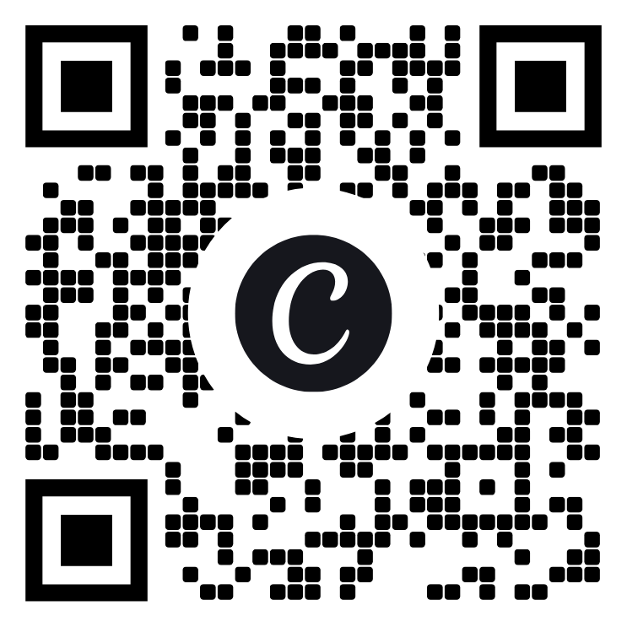
Solomon: UGLE's learning platform
What it is
Use it for the evenings you cannot attend
UGLE’s online learning hub: accurate, approved material for every stage
Papers, Nuggets, presentations, quizzes and the Welcome modules
Free to every member of a UGLE Lodge, at your own pace
When your Lodge works a degree you have not yet taken, you cannot be in the room. That evening is not dead time: meet your mentor, open Solomon, and explore the history, the symbolism of your own degree, or whatever you are curious about.
Solomon sits alongside face-to-face conversation. It never replaces it.
Get started tonight
Scan, or go to solomon.ugle.org.uk
Register: name, Lodge name and number
Start “Welcome Apprentice”
Scan for Solomon
Notes:
If the wifi allows, ask people to sign up there and then.

Slide 22


Solomon Academy and the Diploma
Module 1
Welcome Apprentice
Module 2
Welcome Fellow Craft
Module 3
Welcome Master Mason
Module 4
Welcome Companion
How it works
Your tie pin, presented in Lodge
Work through each module at your own pace
A quiz at the end: score 100% for a certificate, and retake as often as you like
All four certificates earn the Solomon Academy Diploma
Do Welcome Companion when the time is right for you; the Diploma waits
Diploma holders receive UGLE’s Solomon Academy tie pin, worn only by those who have earned it
Hertfordshire presents pins in Lodge: at Gladsmuir Lodge No. 1385, the Light Blues Lodge, or arranged at your own
Finished? Email mentor@hertfordshirefreemasons.org.uk with your Lodge name and number
Notes:
Tom: mention the pins being presented at Gladsmuir on Friday 30 October, and that you will arrange others around Brethren's own meetings between now and January.

Slide 23
Learning ritual without losing sleep
1
2
3
4
Start early
Little and often
Read, then read aloud
Record it
Months, not the week before.
Ten minutes a day beats an hour on Sunday.
Look up any word you do not understand.
Once the phrasing is right, play it back daily.
5
6
7
8
A line at a time
Hold the book
Say it in the room
Understand it
Add the next. Build it up; never swallow it whole.
Someone follows and corrects you afterwards, not during.
Rehearse in the Lodge room, then at the Lodge of Instruction.
Words you understand stay learned.
Nobody has to learn more than the questions and answers between degrees. Many find they want to.
Notes:
Only ever use a Brother to hold the book for anything that touches the ritual itself.

Slide 24


More than just a ceremony
What you gain
More ways to learn, all free
Confidence speaking in front of people
Leadership and teamwork, in a room that wants you to succeed
Friendships across the Province and the Constitution
Something that is yours: your own Lodge’s history, the symbolism, the Royal Arch
The Lodge of Instruction: go, even with no office. Take your mentor the first time
DAWG: the Daily Advancement WhatsApp Group. Ask tonight to be added
The Visitors’ Festival: exemplary degrees chosen for new Brethren to see
Talks, papers, workshops and research Lodges
Ask. The Brother next to you will be delighted
Notes:
Tom's close: learning never ends in Freemasonry. Use mentors, Solomon and the Provincial resources. Most important: enjoy the journey, and share what you learn with others.

Slide 25
3
Fleet House Light Blues Club
Your club: for every Brother in a white or light blue apron, from tonight
Bro Aaron Ball, FHLBC Communications Officer

Slide 26


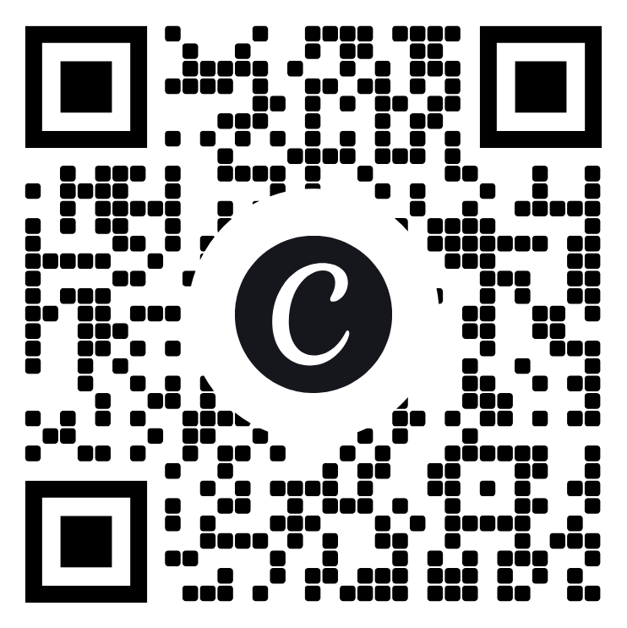

The club for the first part of your journey
Run by its members, for its members: the place most new Masons in Hertfordshire make their first friends outside their own Lodge.
Explore
Discover
Engage
Lodge meetings across Hertfordshire, as a group, with a host Lodge expecting you
Trips to Masonic landmarks, tours, guest speakers and demonstrations
Relaxed socials, a members’ WhatsApp group and The Deacon newsletter
Who can join
Scan to join: two minutes
Any Freemason who lives, works or meets in Hertfordshire and has no Provincial, Grand or Metropolitan rank. Yes, an Entered Apprentice can join. Tonight.
fhlbc.co.uk/join-us. £25 to join, then £10 a year; EAs £10 a year. Welcome pack and pin.
Join the Club
Notes:
Prices as published on fhlbc.co.uk; check them before the night. Have someone on hand to help people join on their phones.

Slide 27
What's coming up
Fri 30 October
Gladsmuir Passing Ceremony
Gladsmuir Lodge No. 1385, Radlett. A Passing, a three-course Festive Board and Solomon Academy tie pin presentations. 6.00 to 9.30pm. Dining £32.
Sun 15 November
FHLBC Annual General Meeting
Here at Halsey Hall, Cheshunt. Free for members. Join before then and have your say in what the Club does next year. 6.00 to 9.00pm.
Full details and booking at fhlbc.co.uk/events. Club ties and pins at fhlbc.co.uk/fhlbc-merchandise.
Patience · Participation · Brotherhood
Notes:
Events as listed on fhlbc.co.uk on 25 October 2026. Close with last year's three guiding thoughts: patience with the journey, participation beyond the ceremonies, and brotherhood: no Mason walks alone.

Slide 28
Three things to do this week
1
2
3
Join the Club
Sign up to Solomon
Message your mentor
fhlbc.co.uk/join-us. Two minutes. Then say hello on the WhatsApp group.
solomon.ugle.org.uk. Start the module that is yours. One certificate is one step to the Diploma.
Tell him one thing from tonight you want to talk about.
Notes:
Make it concrete. If people do one thing, make it the third.

Slide 29

Your questions
From the cards, and from the floor. If we do not know, we will say so and come back to you through your Lodge Mentor.
Notes:
Read the cards first; they hold the questions people will not ask aloud. Write down anything you cannot answer and follow it up.

Slide 30

Thank you. Stay in touch
Provincial Mentoring
Learning
Light Blues Club
mentor@hertfordshirefreemasons.org.uk
asstmentor@hertfordshirefreemasons.org.uk
Provincial Office, Fleet House, 10 Parkway, St Albans AL3 6PA
01727 833061
solomon.ugle.org.uk
Your Lodge Mentor for the Lodge of Instruction and the Visitors’ Festival
DAWG: ask to be added tonight
fhlbc.co.uk
Secretary@fhlbc.co.uk
Join at fhlbc.co.uk/join-us
You are not on this journey alone. And remember: whatever you do, it must be fun! Thank you for coming. Now, the bar.
Notes:
Thank the venue and the Club. Invite everyone to stay, eat, and find the presenters.

